Slide 1
UPDATE
Design & Analysis 1

Slide 2
Updates From Yesterday
After changing the plates to 1/8" Garolite G-10 Only reduced the weight of the frame by 4lbs
Wiring can be held adjacent to the C-bracket as seen from Design & Analysis #2
At this point we are not sure how easily manufacture the material is and believe we should proceed with the current aluminum and polycarbonate set up

Slide 3
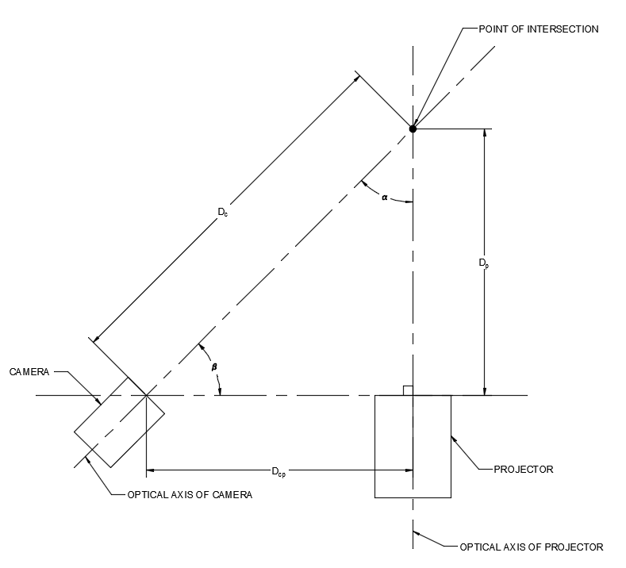
Angle and Arm Length
The angle α between the camera and projector can be calculated using sine law
The angle β can either be read directly off of the mounting plate
Camera support arm should be approximately 27.5” based off of our calculation of D.cp
Allows for a maximum angle of 45 degrees

Slide 4
Future Work
Add Laser pointer into the assembly
Finalize Connection Points to Arm
Finalize housings for mini-DAQ box and Red box connecting to the DLP board
Mount Distance Sensor

